Slide 1

BuyABook
Project Overview
Daniel Fisher, Billy Presume, Nathan Jermann,
Joshua Suess, and Martin Jankowski

Slide 2

What is BuyABook?
Online Marketplace where students can buy and sell textbooks
Localized transactions at the campus level
Full release would offer a seller rating system, ISBN lookup, and price comparison feature

Slide 3
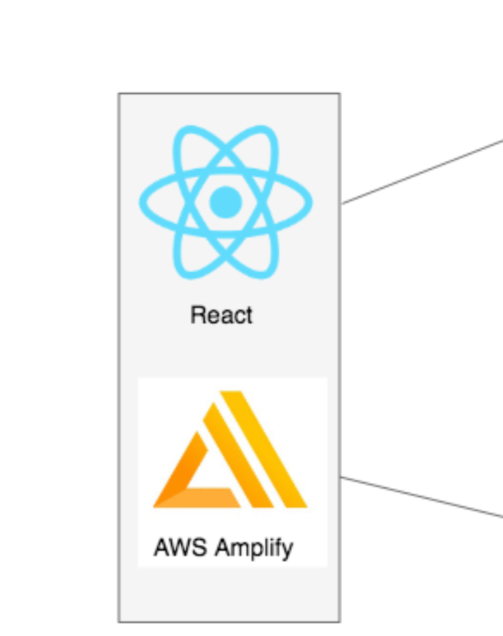
Original Plan
Tech Stack
React framework with DynamoDB backend, connected via AWS Amplify
React is used to develop the front-end web apps using JavaScript
DynamoDB is Amazon’s NO SQL relational database service
AWS Amplify is a serverless framework platform for building scalable web apps.

Slide 4

Initial Problems
Lack of Foresight

Slide 5
The learning curve
No one in the group knew JavaScript
Backend members were unfamiliar with DynamoDB and AWS Amplify

Slide 6
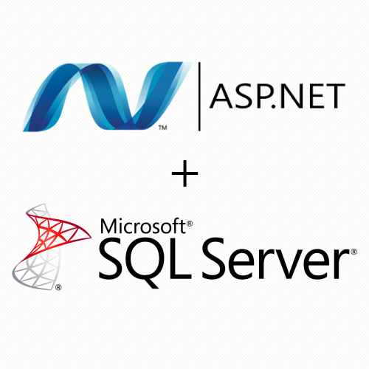
New plan
Tech Stack
ASP.NET is a Server-side web application framework
Microsoft SQL Server is RDBMS developed by Microsoft
EC2 is an Elastic cloud computing Service by AWS
Elastic BeanStalk is used to deploy applications in tandem with other AWS Services
RDS is a distributed Relational Database Service offered by AWS

Slide 7

Development
LOOKING AHEAD

Slide 8
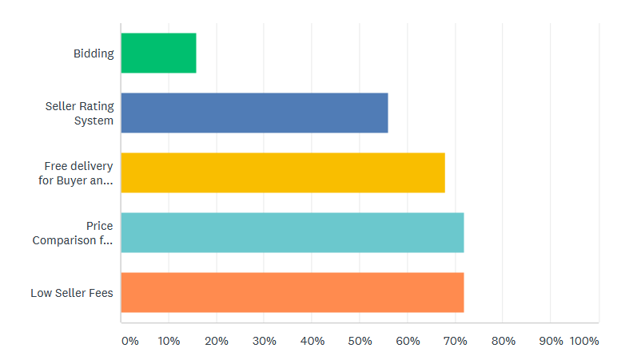

Survey Results
Requested Features:

Slide 9

Survey Results
Almost 60% of participants wanted a website over a mobile app
70% were likely/very likely to use BuyABook over Ebay or Facebook Marketplace
Participants were more likely to buy books than sell them using BuyABook
Suggested Features:
“Get more than a dollar back for a book”
“Search by ISBN number”
“User profiles, in order to get to know the seller”

Slide 10
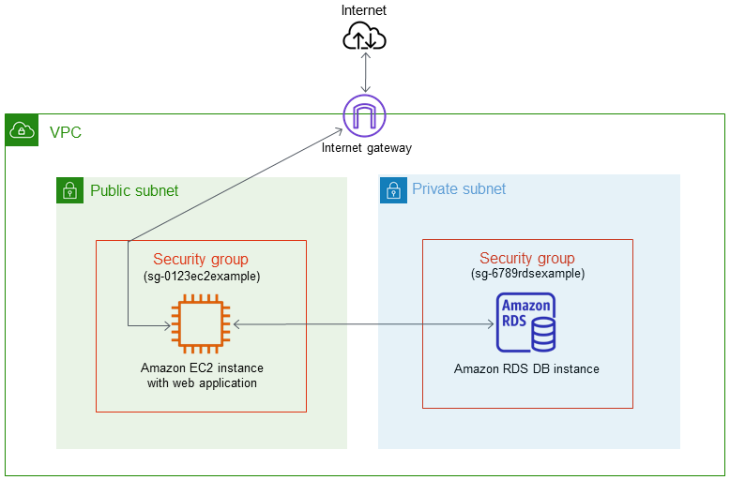
Network layout
Virtual Private Cloud
SQL Server hosted on RDS DB instance
-MSSQL port: 1433
ASP.NET app with access to HTTP and RDP requests
-ports: 80 & 3389

Slide 11
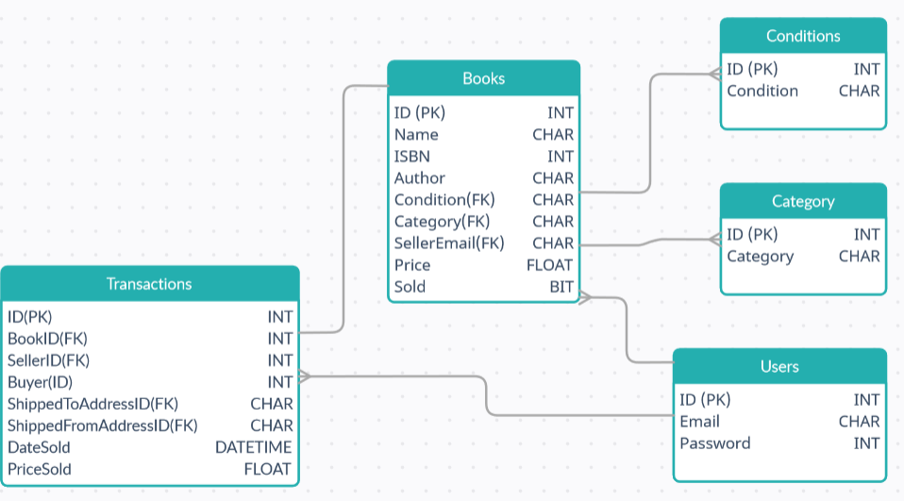
DataBase

Slide 12
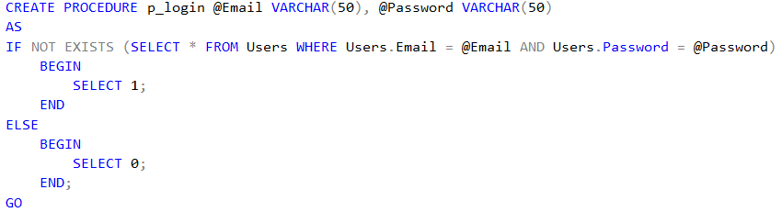
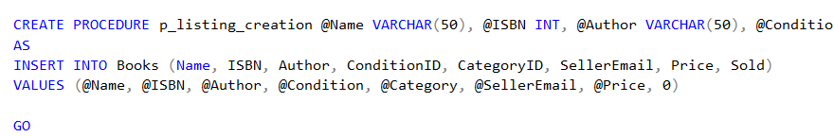
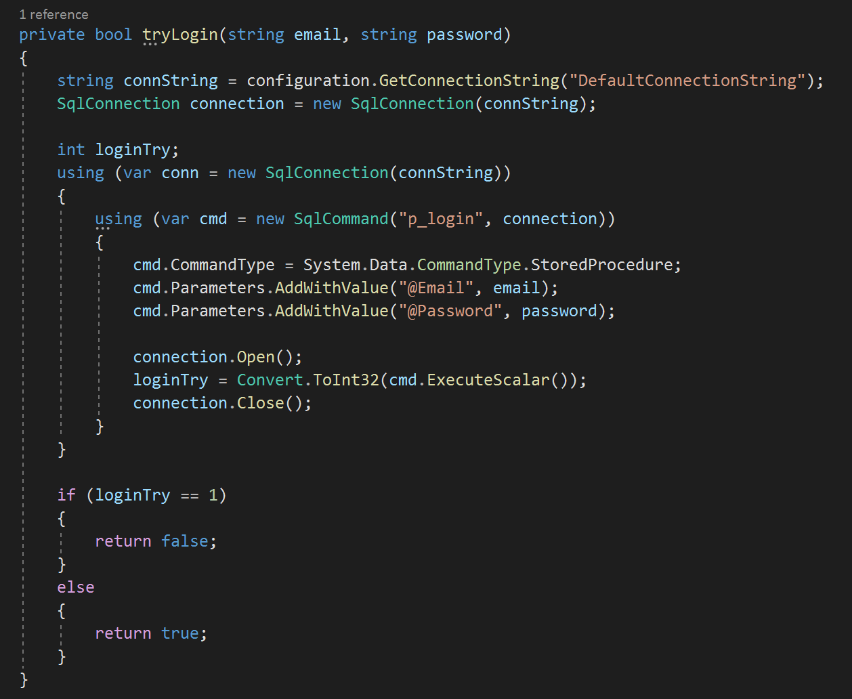
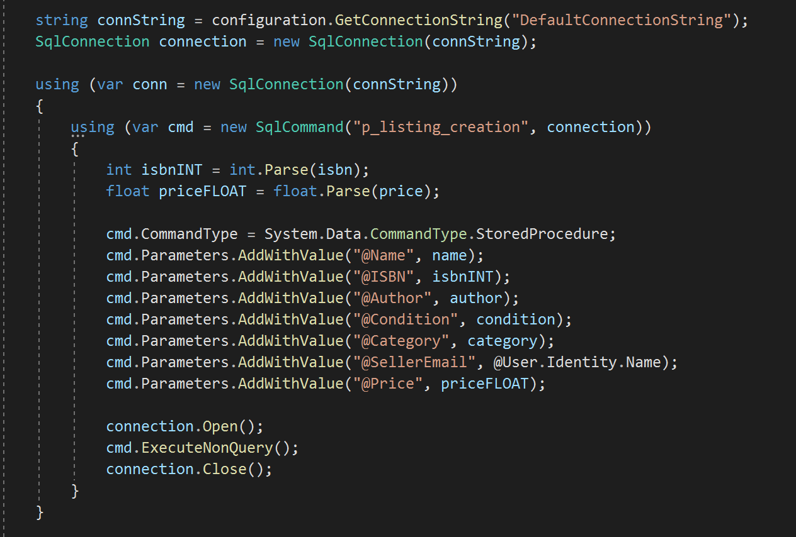
Database

Slide 13
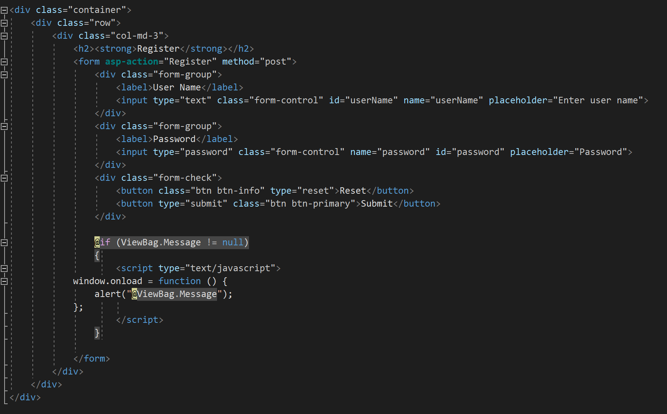
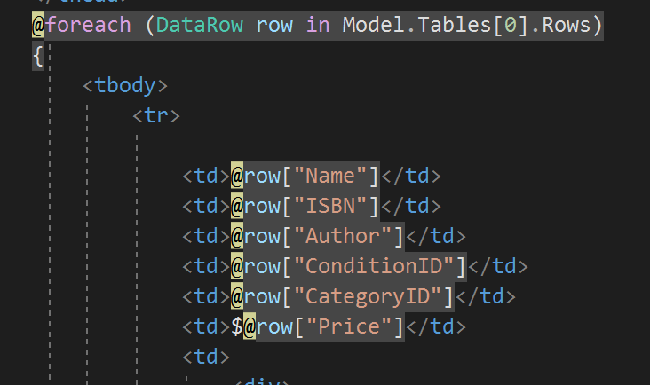
CSHTML / RAZOR View engine
View of Registration HTML
View of Index Table HTML

Slide 14
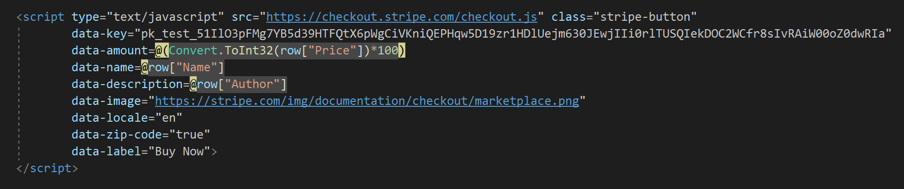
Stripe API & Database connection string
HTML Stripe API
AWS RDS Connection String

Slide 15
AWS ElasticBeanstalk
Final Stages and Deployment

Slide 16

Deployment
Visual Studio supports built-in extensions that allow for quick incorporation of AWS services
Once a project is complete you can “publish” it into an EC2 instance using ElasticBeanstalk
EC2 is placed inside the public subnet of the VPC
RDS EC2 is provisioned inside the private subnet

Slide 17
Testing
Registration |  |  | Login |  |  | Listing |  |  | Buying
Data storage integrity Unique email procedure Cookie creation Consistency on different devices |  |  | Login procedure Data insertion errors Session persistence |  |  | Listing procedure Foreign Key data entry Data insertion errors Permission tracking |  |  | Stipe API Data handoff Permission tracking Data insertion errors Listing persistence
Criteria: Pass/Fail
--Passed
Criteria: Pass/Fail
--Passed
Criteria: Pass/Fail
--3/4
Criteria: Pass/Fail
--Passed

Slide 18



Security Analysis
USER PRIVACY
User data is stored on a private network secured by AWS protocols
Stripe API configured to protect payment information
DATA BACKUPS
RDS is designed to backup data periodically using AWS’s built in cloud features
All data is stored on provisioned EC2s which are known for reliability
NETWORK SECURITY
Restricted port access
Web app accesses internet through INT-Gatway
Built-in DNS Firewall and custom security groups

Slide 19

SUMMARY
BASIC FUNCTIONALITY
Users are able to register, login, list, and buy
SUCCESSFUL DEPLOYMENT
BuyABook has a working URL
WORKING SECURITY
Customer data is secure, and the application is defended against most cyber attacks
EASY SCALABILITY
There is a clear plan for the features required for version 1.0

Slide 20
THANK YOU
Questions?

